Slide 1
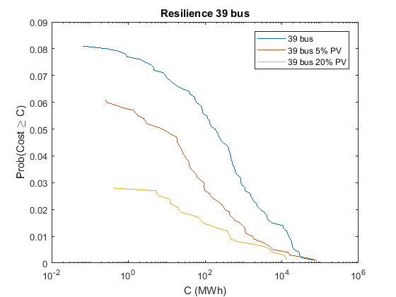
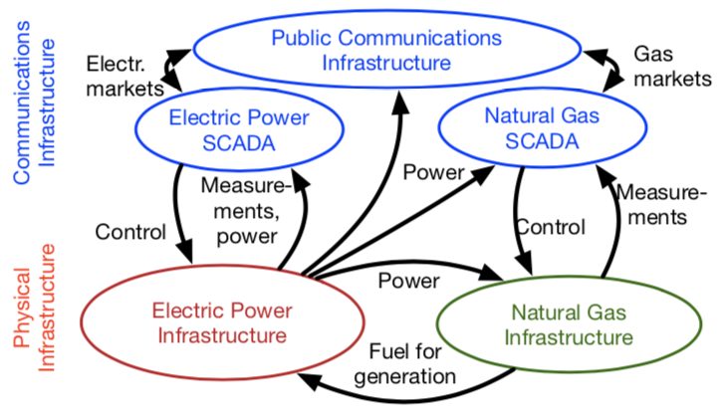
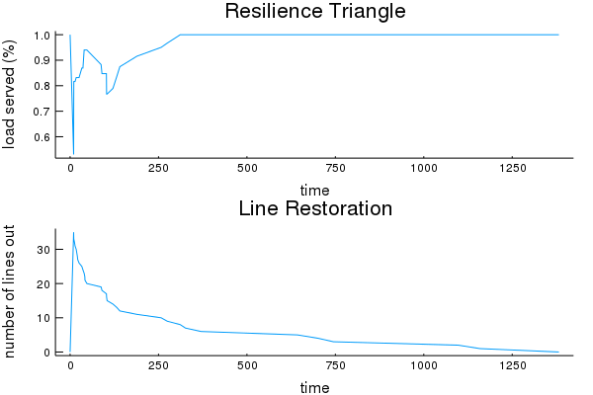
Measuring Power System Resilience Based on Empirical Data
Molly Rose Kelly-Gorham, Paul Hines, Ian Dobson (ISU)
Abstract
Measuring Resilience of Power Systems
Preliminary Results
This work provides a new integrated approach to quantify resilience in electric power transmission networks and demonstrates the approach by measuring the impact of potential improvements to a power system. A novel aspect is the use of empirical data to develop the probability distributions that drive the model. Research on power system resilience is motivated by climate change, which increases the severity of large storms, and concerns about potential attacks on the electricity infrastructure. A key first step is to quantify the overall resilience of a particular power system.
A measure of the resilience of a power system to a single event is to integrate the unserved demand over time.
Event
Restore
Initial Outages
Cascade
Resilience
Measure
Robustness
Rapid Restoration
Redundancy
Resourcefulness
Empirically Based Model
Future Work
Update
Background
Initiate outages
Outages-> Initial lost load, LSOPF
Restoration, LROPF
Resilience metrics
There is a broad existing literature which focuses on each individual stage of the resilience problem, such as component reliability, or cascading failures, or restoration, but there is not much previous work that analyzes all the stages of resilience together to quantify the overall resilience. Some comprehensive efforts have produced frameworks and metrics to measure resilience [1,2] and have estimated system resilience to certain hazards by applying a good measure of component outages into a resilience framework [3] \cite{Bruneau:Resilience-earthquake,Panteli:MetricsResilience}, \cite{Panteli:Fragil-Prob-Adapt}.
Coupling power system, natural gas and communication system models

